Slide 1
Teaching Sensitive Subjects

Slide 2

This tutorial, “Teaching with Primary Sources,” is one of a series produced by the North Carolina State Historical Records Advisory Board with funding from the National Historical Records & Records Commission.

Slide 3
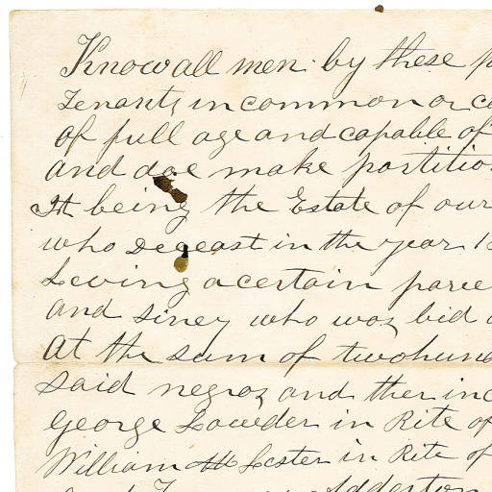
Many events in history produced, and in some cases continue to produce, strong and conflicting emotions. It is important for students not only to know about these events in history but to be able to think critically about them and draw their own conclusions.
Bill of sale for two slaves
Stanly County Museum of History, DPLA

Slide 4
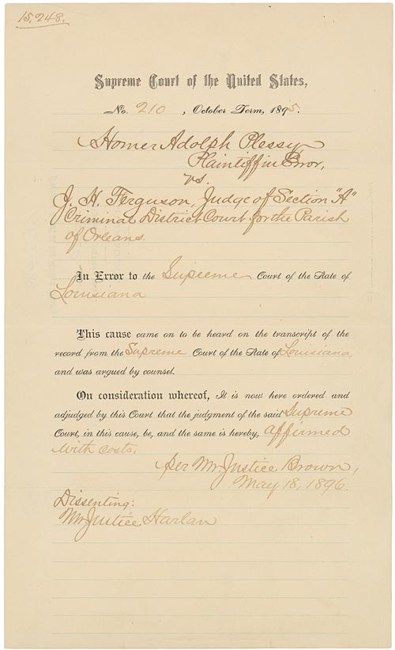
Learning to examine and evaluate the primary documents related to such topics contribute to understanding events in history.
Here are some tips for introducing sensitive topics in your classroom.
Plessy vs. Ferguson, Judgement, Decided May 18, 1896; Records of the Supreme Court of the United States; Record Group 267; Plessy v. Ferguson, 163, #15248, National Archives.

Slide 5
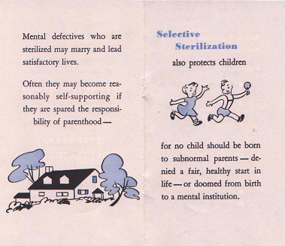
First, identify which topics may be controversial, so you can be prepared to effectively lead discussions. Consider that some topics may raise other controversial issues. For instance, a study of a court case on reproductive rights may include a discussion of eugenics.
1950 Eugenics Pamphlet
NCpedia

Slide 6

When introducing the topic, ask what students already know about the issue. This may reveal existing biases and viewpoints.
Classroom Cliipart

Slide 7
Present multiple perspectives on the topic. Finding quotes from secondary sources may be useful.
I think there are many times when it would be most efficient to use nuclear weapons.
Curtis LeMay
Brainy Quotes
My feelings of revulsion and foreboding about nuclear weapons had not changed an iota since 1945, and they have never left me.
Daniel Ellsberg
Brainy Quotes

Slide 8



Assign background reading in secondary sources.
Free clip art

Slide 9
Before beginning analysis of the document, provide ground rules for discussion.
Rules of Engagement
All opinions are to be respected.
No one may interrupt while another is speaking.
Personal attacks and sarcasm are forbidden.
Focus on issues not on the person expressing an opinion.

Slide 10
Be an effective facilitator
Enforce the rules.
Intervene if the discussion gets too heated.

Slide 11

Once the discussion has ended, have students provide an objective summary of the different viewpoints presented.
Viewpoint A Viewpoint B
Viewpoint C

Slide 12
An online search for teaching sensitive or controversial subjects will provide numerous articles. Here are a few:
LearnNC
http://www.learnnc.org/lp/editions/nchist-eg/6633
Yale Center for Teaching and Learning
http://ctl.yale.edu/teaching/ideas-teaching/teaching-controversial-topics
University of Michigan Center for Research on Learning and Teaching
http://www.crlt.umich.edu/tstrategies/tsd

